Slide 1
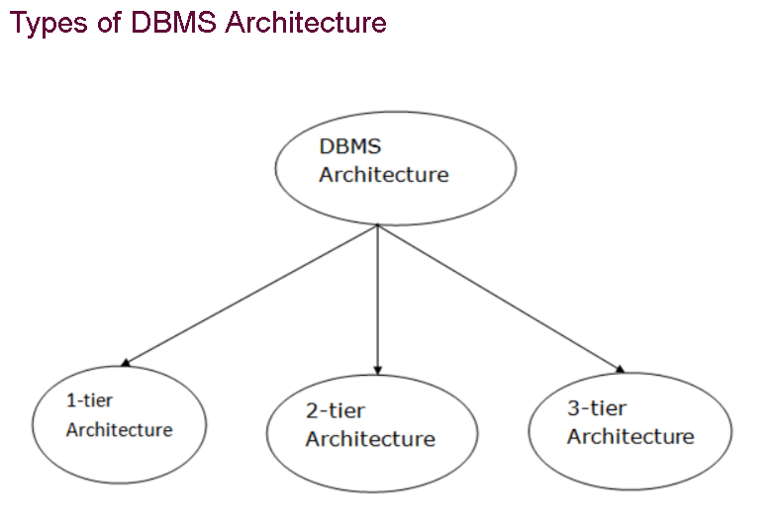
DBMS ARCHITECTURE

Slide 2
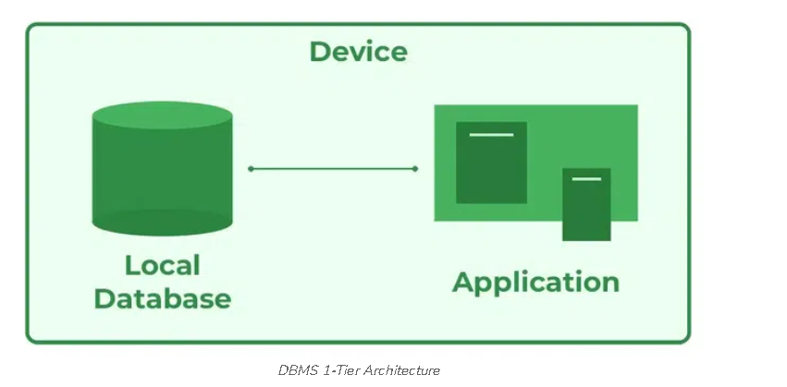
1-Tier Architecture
In this architecture, the database is directly available to the user. It means the user can directly sit on the DBMS and uses it.
the client, server, and Database are all present on the same machine
Any changes done here will directly be done on the database itself
The 1-Tier architecture is used for development of the local application, where programmers can directly communicate with the database for the quick response.

Slide 3
Advantages
Simple Architecture: 1-Tier Architecture is the most simple architecture to set up, as only a single machine is required to maintain it.
Cost-Effective: No additional hardware is required for implementing 1-Tier Architecture, which makes it cost-effective.
Easy to Implement: only in small projects

Slide 4
2-Tier Architecture
The 2-Tier architecture is same as basic client-server. In the two-tier architecture, applications
the client end can directly communicate with the database at the server side
The user interfaces and application programs are run on the client-side.
The server side is responsible to provide the functionalities like: query processing and transaction management.

Slide 5
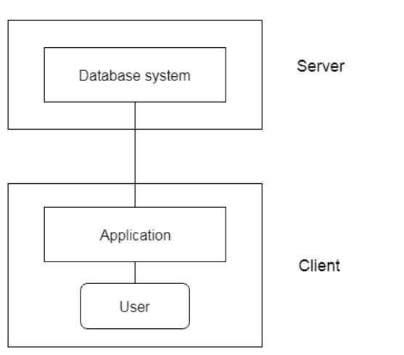

Slide 6
advantages
Easy to Access: 2-Tier Architecture makes easy access to the database,
Scalable: by adding clients or upgrading hardware
Low Cost: 2-Tier Architecture is cheaper than 3-Tier Architecture
Simple: 2-Tier Architecture is easily understandable as well as simple because of only two components.

Slide 7
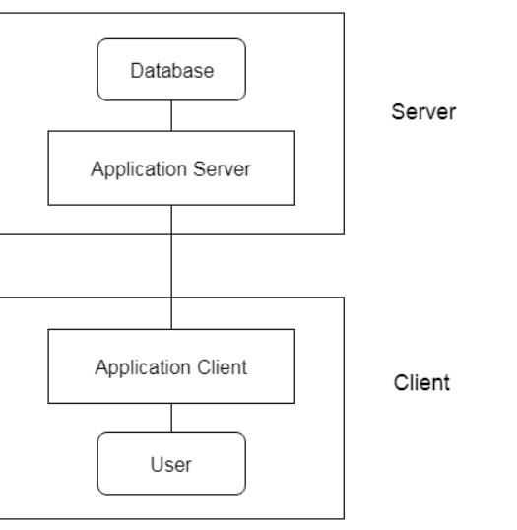
3-Tier Architecture
The 3-Tier architecture contains another layer between the client and server. In this architecture, client can't directly communicate with the server.
The application on the client-end interacts with an application server which further communicates with the database system.

Slide 8
Data Integrity: 3-Tier Architecture maintains Data Integrity. Since there is a middle layer between the client and the server, data corruption can be avoided/removed.
Security: 3-Tier Architecture Improves Security. This type of model prevents direct interaction of the client with the server thereby reducing access to unauthorized data.

Slide 9
Different Types of Database Users in DBMS
Application Programmers
As its name shows, application programmers are the one who writes application programs that uses the database. These application programs are written in programming languages like COBOL or PL (Programming Language 1), Java and fourth generation language.
These programs meet the user requirement and made according to user requirements. Retrieving information, creating new information and changing existing information is done by these application programs.
End Users
End users are those who access the database from the terminal end. They use the developed applications and they don’t have any knowledge about the design and working of database.
These are the second class of users and their main motto is just to get their task done..
SQL Programmer
These users have great knowledge of query language.
Casual users access data by entering different queries from the terminal end.
They do not write programs but they can interact with the system by writing queries.

Slide 10
Database Administrator
DBA can be a single person or it can be a group of person. Database Administrator is responsible for everything that is related to database. He makes the policies, strategies and provides technical supports.
Responsibilities include designing, implementing, and maintaining the database system; establishing policies and procedures pertaining to the management, security, maintenance, and use of the database management system.
System Analyst(DB Architect)
System analyst is responsible for the design, structure and properties of database. All the requirements of the end users are handled by system analyst. Feasibility, economic and technical aspects of DBMS is the main concern of system analyst.

Slide 11
Video
https://in.video.search.yahoo.com/search/video?fr=mcafee&p=database+management+system+architecture+video&type=E210IN885G0#id=5&vid=e1499f91a511d3ce909480301250825a&action=click

